Slide 1
Model View Presenter
Design Pattern
Jay Smith
PMO Architect and Evangelist
Tyson Foods, Inc.
http://jaysmith.us

Slide 2
Agenda
Introduction
The Winds of Change
Model View Controller/Presenter
The Model, View, and the Controller/Presenter
Demo
Summary
Resources
Contact Information
http://jaysmith.us

Slide 3
The Winds of Change
Microsoft .NET Framework Releases
.NET Framework 1.0 2002
.NET Framework 1.1 2003 1 Year
.NET Framework 2.0 2005 2 Years
.NET Framework 3.0 2006 1 Year
.NET Framework 3.5 B2 2007 1 Year
http://jaysmith.us

Slide 4
Observation
Every piece of code
in the UI is costly!
http://jaysmith.us

Slide 5
Model View Controller/Presenter
Model-view-controller (MVC) is an architectural pattern used in software engineering. In complex computer applications that present a large amount of data to the user, a developer often wishes to separate data (model) and user interface (view) concerns, so that changes to the user interface will not affect data handling, and that the data can be reorganized without changing the user interface. The model-view-controller solves this problem by decoupling data access and business logic from data presentation and user interaction, by introducing an intermediate component: the controller.
http://jaysmith.us

Slide 6
The Model
Just like ASP.Net, WinForms does not strictly require a model.
The developer has the option to create a model class, but may choose to forget it and have the event handlers in the controller perform any calculations and data persistence.
Again, using a model to encapsulate business rules and database access is both possible and preferable. It is left to developers to design the Model.
http://jaysmith.us

Slide 7
The View
A class inheriting from either Form or Control handles the responsibilities of the view. In the case of WinForms, the View and Controller are compiled into the same class. This differs from ASP.Net, which uses inheritance, and Smalltalk, which have separate classes with pointers to one another.
http://jaysmith.us

Slide 8
The Controller/Presenter
The duties of the controller are split between three places.
The generation and passing of events starts at the OS level. Inside the .Net framework, the Form and Control classes route the event to the proper event handler.
The event handlers typically reside in the Form or Control class and are implemented as delegates for the user interface events (e.g. button click, form load, listbox selection changed).
http://jaysmith.us

Slide 9
DEMO
http://jaysmith.us

Slide 10
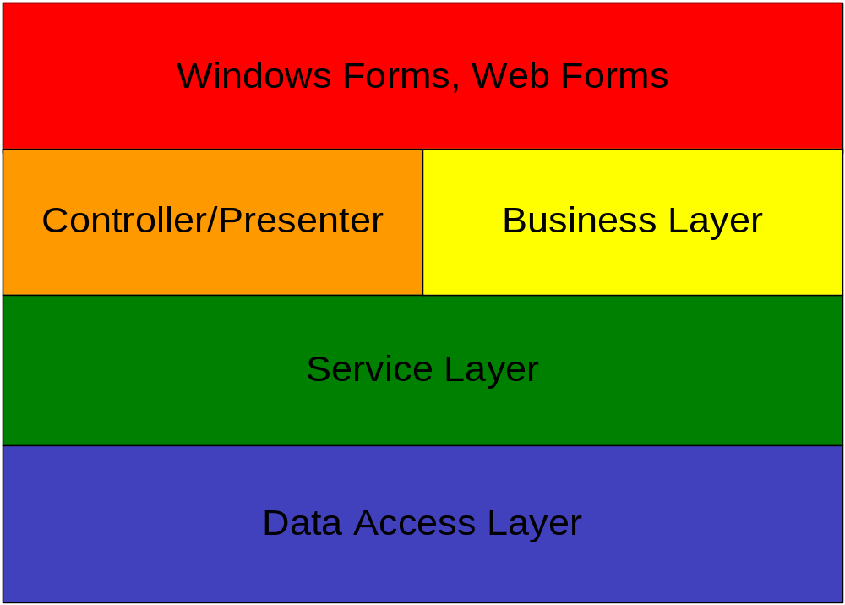
Model View Presenter
http://jaysmith.us

Slide 11
Summary
Code in the UI is Costly
Remove as Much Code as Possible from the UI Layer
Increased Encapsulation
Easier To Test
Greater Code Reuse
http://jaysmith.us

Slide 12
Resources
Martin Fowler - http://martinfowler.com
.NET Framework - http://en.wikipedia.org/wiki/.NET_Framework
Head First Design Patterns - Eric Freeman & Elisabeth Freeman
Design Patterns in C# - Steven Metsker
Design Patterns for Dummies - Steve Holzner, PhD
The Polymorphic Podcast - http://polymorphicpodcast.com
http://jaysmith.us

Slide 13
Contact Info
Jay Smith - jay@jaysmith.us
http://jaysmith.us
Twitter – http://twitter.com/JaySmith
LinkedIn - http://www.linkedin.com/in/jaywsmith
NWA .NET User Group - http://nwadnug.org
http://jaysmith.us

